Slide 1
EastWest Bank Assessment Dataset
Kate Diwatin

Slide 2

Determining the Predictor variables to effectively predict Target Variable

Slide 3

The solution
What is Regression? Regression analysis is a form of predictive modelling technique which investigates the relationship between a dependant and independent variable.
what is Logistic Regression and why? Logistic Regression produces results in a binary format which is used to predict the outcome of the categorical dependant variable.
So the output should be discrete/categorical.

Slide 4
Data Analysis Process
Visualize and Share Findings
Analyze the Data
Clean the Data

Slide 5
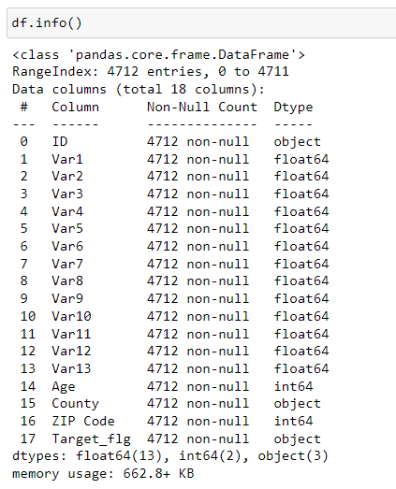
Data Cleaning
1 Target Variable
16 Predictor Variables
4,712 records

Slide 6
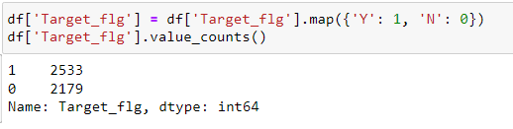
Data Cleaning
Converted ‘Target_flg’ variables from object (Y, N) to float (1,0)

Slide 7
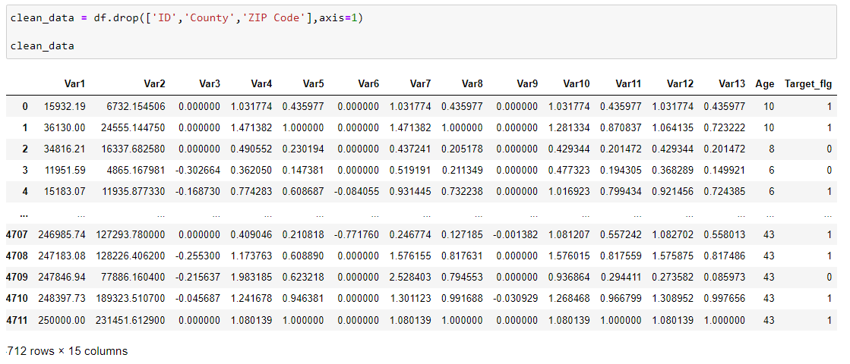
Data Cleaning
Dropped data values:
ID
Country
ZIP Code

Slide 8
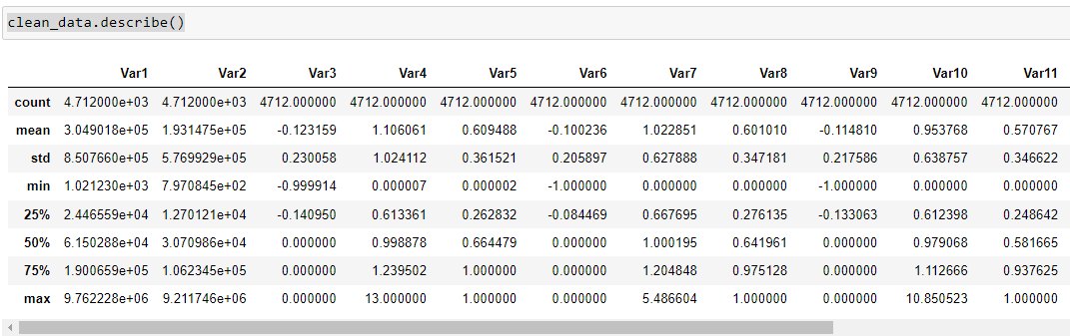
Data Analysis
The describe() method returns description of the data in the DataFrame.
count - The number of not-empty values.
mean - The average (mean) value.
std - The standard deviation.
min - the minimum value.
25% - The 25% percentile*.
50% - The 50% percentile*.
75% - The 75% percentile*.
max - the maximum value.

Slide 9
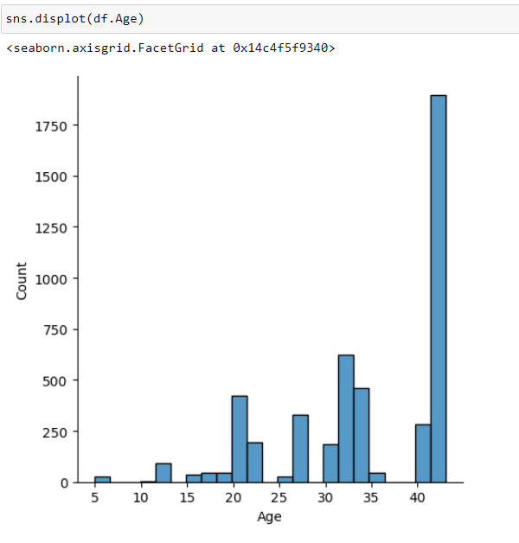
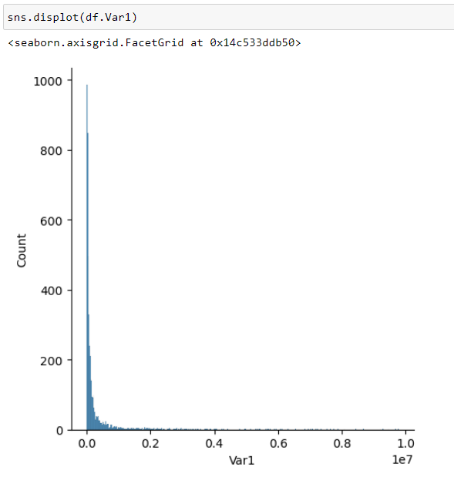
Exploratory Data Analysis
Age Count
Var1 Count

Slide 10
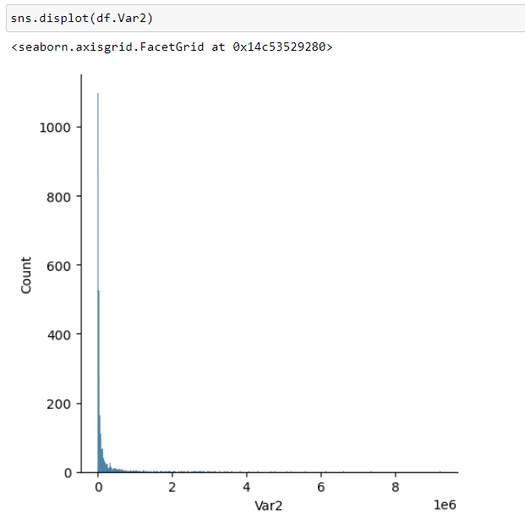
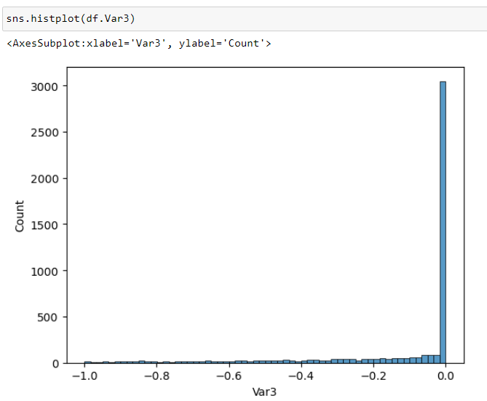
Exploratory Data Analysis
Var2 Count
Var3 Count

Slide 11
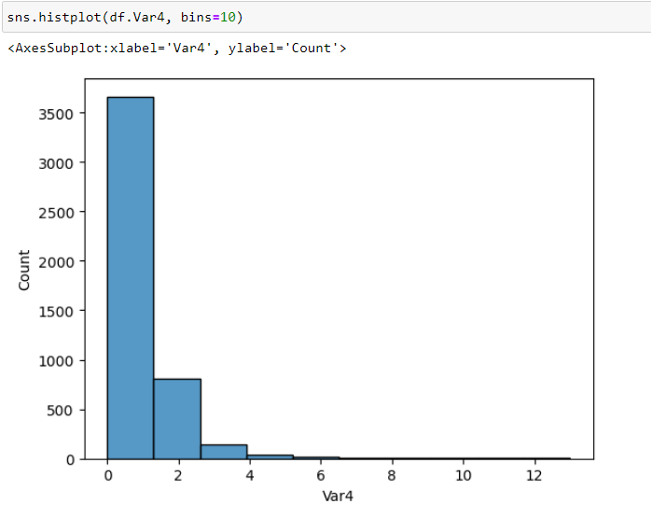
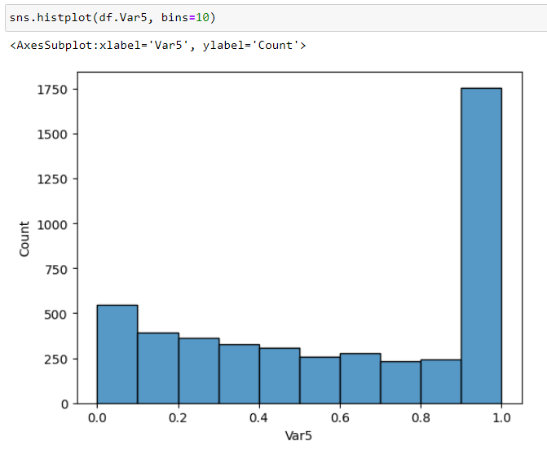
Exploratory Data Analysis
Var4 Count
Var5 Count

Slide 12
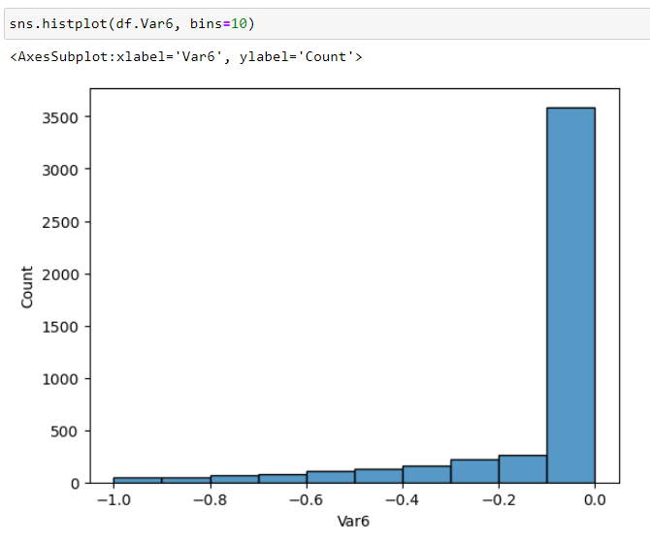
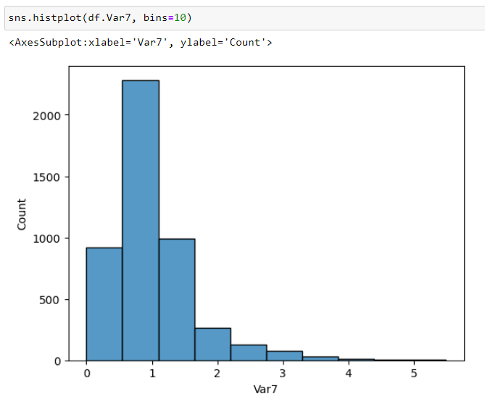
Exploratory Data Analysis
Var6 Count
Var7 Count

Slide 13
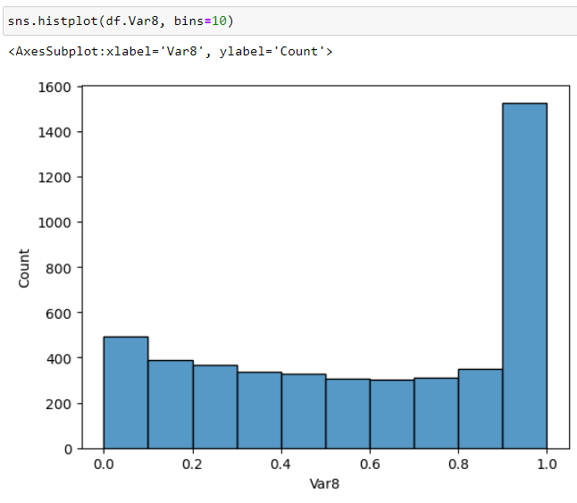
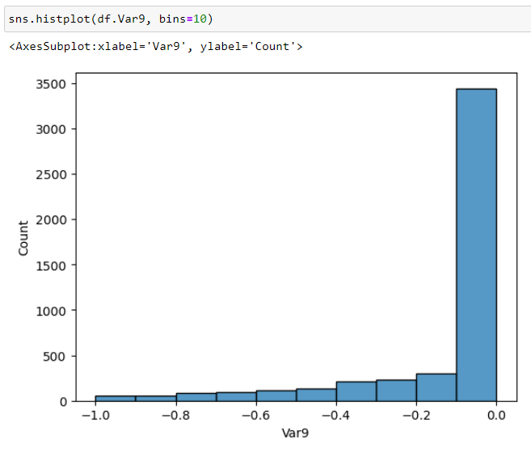
Exploratory Data Analysis
Var8 Count
Var9 Count

Slide 14
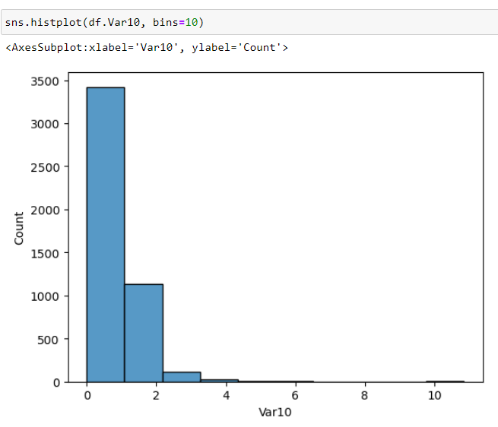
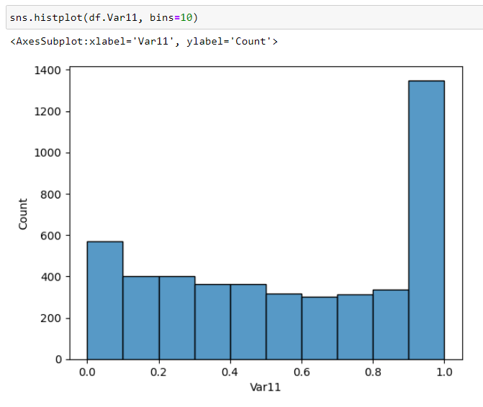
Exploratory Data Analysis
Var10 Count
Var11 Count

Slide 15
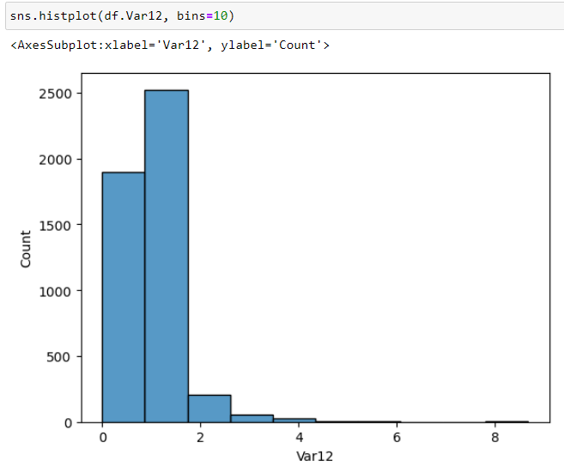
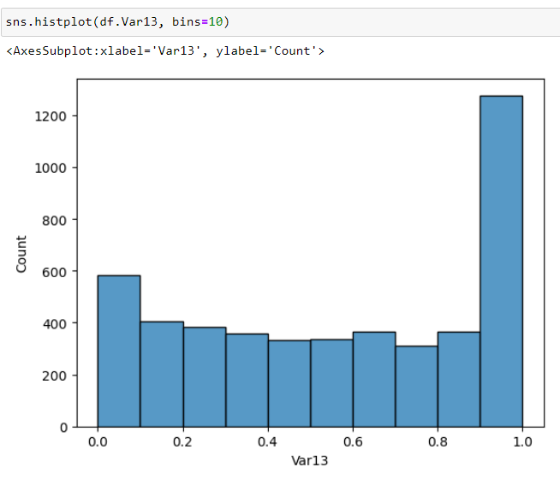
Exploratory Data Analysis
Var12 Count
Var13 Count

Slide 16
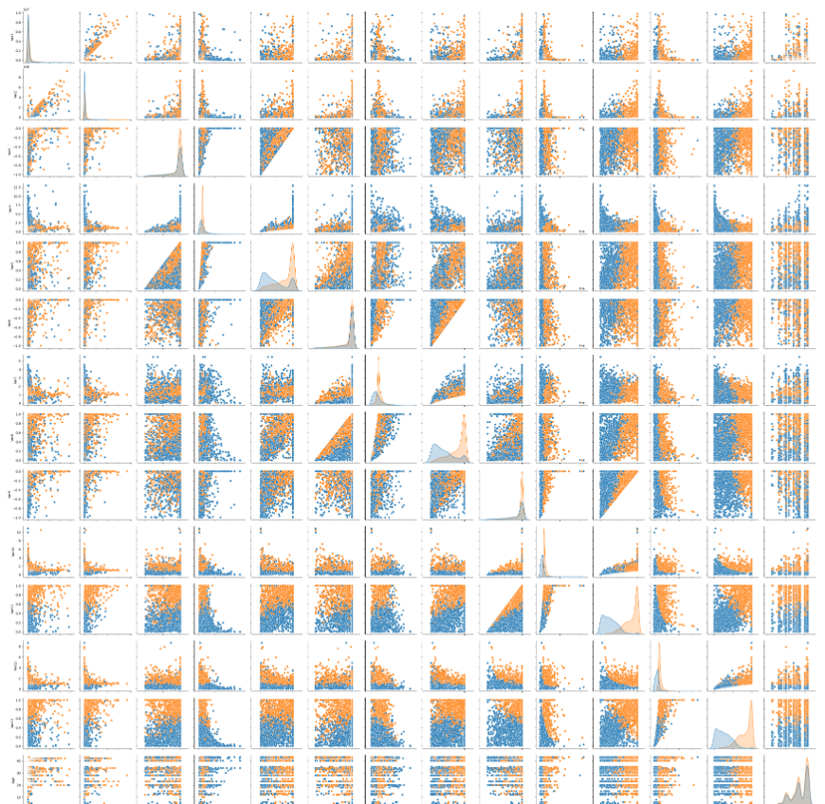
Exploratory Data Analysis
Pair Plot
Pair plot is used to understand the best set of features to explain a relationship between two variables or to form the most separated clusters. It also helps to form some simple classification models by drawing some simple lines or make linear separation in our data-set.

Slide 17
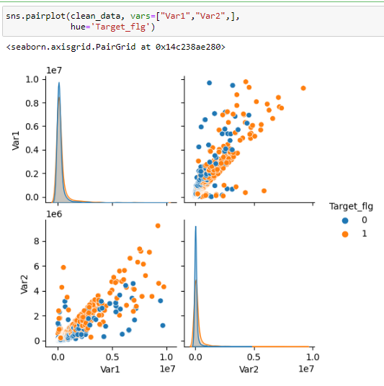
Exploratory Data Analysis
Pair Plot
reduce the clutter by plotting diagrams with significance

Slide 18

Logistic Regression and Prediction

Slide 19
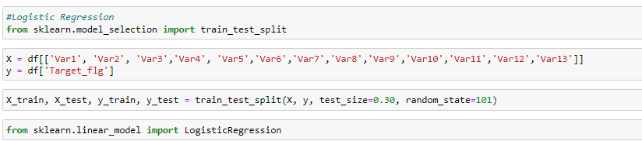
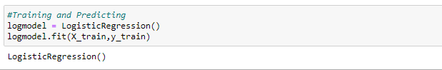
Logistic Regression
Split the data into training set and testing set using train_test_split
Train and fit a logistic regression model on the training set.

Slide 20
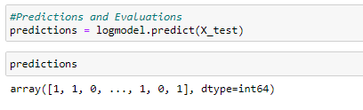
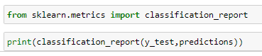
Predictions and Evaluations
Now predict values for the testing data.
Create a classification report for the model.

Slide 21
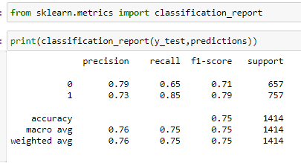
Predictions and Evaluations
Now predict values for the testing data.
Create a classification report for the model.

Slide 22
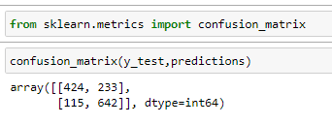
Confusion Matrix
The result is telling us that we have 424+642 correct predictions and 233+115 incorrect predictions.

Slide 23

Conclusion ?
Possible Predictor Variables: Var1, Var2, and ‘Age’

